Slide 1
Lisa K Rawlins
Maury Rawlins Brown, LLC
Managing Partner
FL HIMSS HIT Days, Tallahassee, FL
April 24, 2019

Slide 2
Presentation Objectives
Introductions Maury Rawlins Brown, LLC
How a Bill Becomes a Law
Florida Healthcare Update: What’s been happening on “The Hill”
Florida Telemedicine & Interoperability Bills

Slide 3
WHAT WE ARE
Maury Rawlins & Brown
Maury Rawlins & Brown is a Fort Lauderdale, Tallahassee, and Seattle based public affairs consulting firm, offering over three decades of Florida political and business experience in strategic public affairs and legislative advocacy. We are passionate to earn your respect and trust by being client centered, reliable, with long-term aspirations and the desire to strive for excellence.
We strive to assist organizations navigate through the ebb and flow of Florida government. We hold the belief that powerful and effective representation begins with understanding each clients unique situation and mission. The firm consistently delivers sound, effective and strategic advice to some of the nations’ best-known entities and brands. We endeavor to champion, leverage and accomplish on your behalf.
ENTERTAINMENT

Slide 4
Place subtitle here (30pt Verdana) or remove slide

Slide 8
How A Bill Becomes A Law
Compare and contrast to Federal and State Process

Slide 9
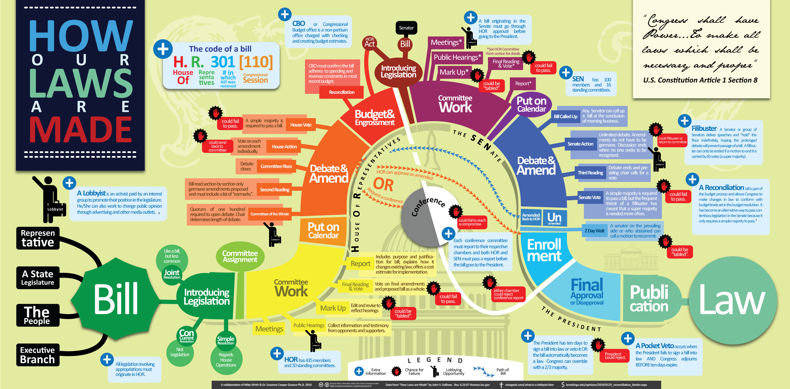

Slide 10
Examples of current Florida Law
And the actual stories behind the process

Slide 11
HOW AN IDEA BECOMES A LAW BY THE PEOPLE

Slide 12
HOW AN IDEA BECOMES A LAW FROM THE EXECUTIVE BRANCH

Slide 13
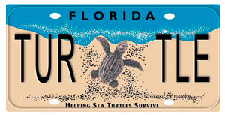
HOW AN IDEA BECOMES A LAW BY A REPRESENATIVE

Slide 14
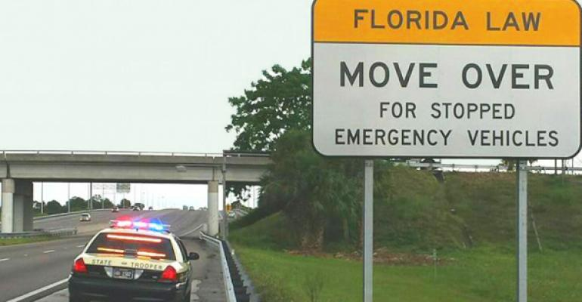
HOW AN IDEA BECOMES A LAW FROM A REPRESNTATIVE

Slide 16
Florida Healthcare Update: What’s been happening on “The Hill”

Slide 17
Governor DeSantis and Lt. Governor Nunez
A Bold Vision for a Brighter Future

Slide 18
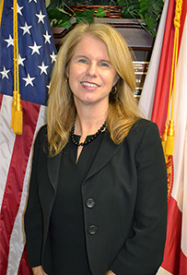
AHCA SECRETARY MARY MAYHEW
Mayhew currently serves as the Secretary for
the AHCA, appointed by Governor Ron DeSantis
in January 2019. Most recently, Mayhew
served as the deputy administrator and director
of Medicaid and the Children’s Health Insurance
Program for the Centers for Medicare and
Medicaid Services. Previously Mayhew was
appointed by Governor Paul R. LePage in 2011
to be the Commissioner of the Department of
Health and Human Services,
Mayhew served more than six years at the helm
of Maine’s largest state agency.
She managed many of the state’s most vital
programs, including MaineCare (Maine’s
Medicaid program), Aging and Disability Services
Child Welfare, Adult Protective Services
Substance Abuse and Mental Health Services,
Food Stamps (SNAP), TANF, child support
enforcement, agency licensure and public health.

Slide 19
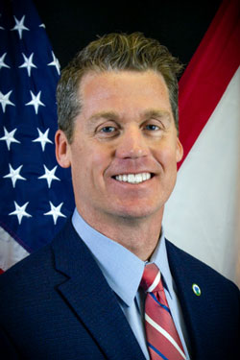
For nearly 20 years, Secretary Chad Poppell has
dedicated his time to serving Florida and local
government. He is dedicated to ensuring that
families have the highest quality of services
available in their times of need and that they are
delivered at the best value to Florida’s taxpayers.
Secretary Poppell has extensive experience in
leading large government programs, including
systems of care delivered through third parties.
He is dedicated to innovation, making sure the
department’s service delivery systems are
appropriately resourced, and to making meaningful
change that will enhance the lives of Florida’s
children and families. Secretary Poppell came to
Tallahassee from Jacksonville in 2013 to serve as
the Chief of Staff for the Department of Economic
Opportunity and then as the Secretary of the
Department of Management Services.
Following a brief time in the private sector, the
Governor charged him to review the department’s
program with fresh eyes and a new perspective.
Secretary Chad Poppell, Department of Children and Families

Slide 20
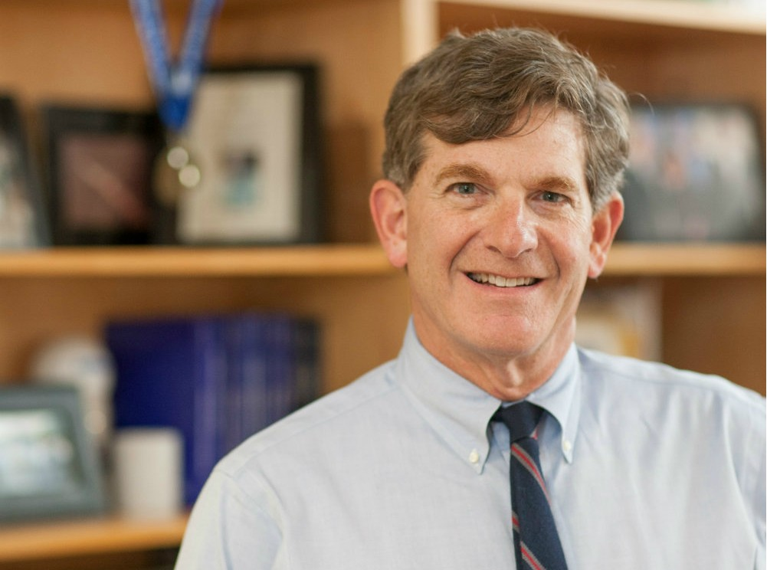
Gov. Ron DeSantis on Monday named a top
University of Florida doctor and professor
as the state’s next surgeon general.
DeSantis announced that he was appointing
physician Scott Rivkees as surgeon general,
a position that doubles as secretary of the
Florida Department of Health.
Rivkees has spent the last seven years as
chairman of the University of Florida’s
Department of Pediatrics, where he oversees
more than 120 faculty members. The
department’s clinical programs are based
at UF Health Shands Children’s Hospital.
Rivkees is a graduate of the New Jersey
Medical School and did postdoctoral and
resident work at Harvard Medical School.
Scott Rivkees, Surgeon General

Slide 21
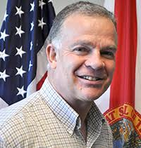
January 2019, Governor Ron DeSantis appointed Richard Prudom as Secretary for the Florida Department of Elder Affairs (DOEA), the State Unit on Aging, whose mission is to help Florida’s 5.5 million elders remain healthy, safe, and independent.
Secretary Prudom has more than 30 years in executive leadership with the State of Florida where he has worked to develop, implement, and lead public policies and programs that improve the lives of Florida families. Since 2011, he has served at the Department of Elder Affairs as Deputy Secretary, Chief of Staff, and Chief Financial Officer.
During his time at DOEA, Prudom also led several initiatives, including the Dementia Care and Cure Initiative (DCCI) and the revitalization of the Communities for a Lifetime Initiative.
DCCI was developed in response to the increasing incidence of Alzheimer’s disease and related dementias in Florida. Through the initiative, DOEA aims to increase awareness of dementia, provide assistance to dementia-caring communities, and continue advocacy for care and cure programs.
Mr. Prudom also leads the Department’s efforts to make Florida an Age-Friendly State in close partnership with AARP and their Network of Age-Friendly Communities.
Prudom received his Bachelor of Arts from the University of Kent in the United Kingdom. In September 2014, Prudom took the oath to become an American citizen and now enjoys dual citizenship with the United Kingdom.
Secretary Prudom, Department of Elder Affairs

Slide 22
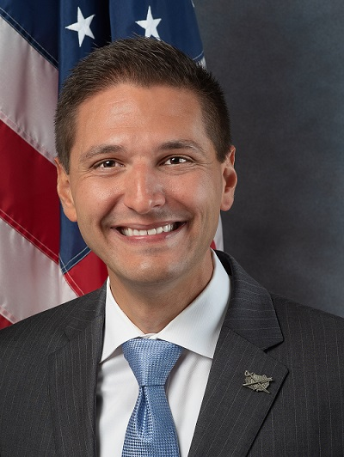
Helping to connect the Sunshine State’s more
than 1.5 million veterans and their families with
earned services, benefits and support are the
more than 1,100 men and women of the Florida
Department of Veterans’ Affairs. They play a
major role in the direct infusion of more than
$18.4 billion annually for veterans into Florida’s
economy through federal compensation,
education and pension benefits, U.S. Department
of Veterans Affairs’ medical services and military
retired pay. Florida offers unique benefits such
as in-state tuition rates for veterans and their
families using the Post-9/11 GI Bill®, several
layers of property tax exemptions, expanded
veterans’ preference, and extensive benefits,
licensure and fee waivers for many activities and
occupations. They offer high quality care at the
network of seven state veterans’ homes, with two
additional homes in development in Port St. Lucie
and Orlando. An Army Reserve Captain and
former state legislator.
Danny Burgess, Executive Director Florida Department of Veterans’ Affairs

Slide 23
2019 Telehealth Legislation
HB 947 - Telehealth General Bill by Rep. Ausley
Last Event: 1st Reading on Tuesday, March 5, 2019 11:28 PM
CS/SB 1526 - Telehealth, by Appropriations and Harrell
Telehealth: Establishing standards of practice for telehealth providers; providing that a nonphysician telehealth provider using telehealth and acting within his or her relevant scope of practice is not deemed to be practicing medicine without a license; prohibiting a contract between a certain health insurer and a telehealth provider from requiring the telehealth provider to be reimbursed at lesser amount than if the service were provided in person; prohibiting a contract between a certain health maintenance organization and a telehealth provider from requiring the telehealth provider to be reimbursed at lesser amount than if the service were provided in-person, etc.
Effective Date: Except as otherwise provided, this act shall take effect July 1, 2019
Last Event: 04/22/19 S Placed on Calendar, on 2nd reading on Monday, April 22, 2019 4:55 PM

Slide 24
2019 Telehealth Legislation
CS/CS/HB 23 – Telehealth: by Health & Human Services Committee and Ways & Means Committee and Yarborough (CO-SPONSORS) Donalds; Mercado
Telehealth: Establishes standard of care for telehealth providers; authorizes telehealth providers to use telehealth to perform patient evaluations; authorizes certain telehealth providers to use telehealth to prescribe specified controlled substances; provides that nonphysician telehealth provider using telehealth & acting within scope of practice is not deemed to be practicing medicine without license; provides that health insurer or HMO is allowed tax credit against specified tax imposed if it covers services provided by telehealth providers.
Effective Date: July 1, 2019
Last Event: 04/22/19 S Received -SJ 392 on Monday, April 22, 2019 3:48 PM
Referred Committees and Committee Actions

Slide 25
2019 Interoperability Legislation
SB 1570: Information Technology Reorganization by Senator Hooper
HB 5301: Information Technology Reorganization by Committee
HB 503 Healthcare Innovation by Rep. James Grant
HB 1255 Modernizing Government by Rep. James Grant

Slide 26
2019 Interoperability Legislation
SB 1544: Data Innovation by Senator Gayle Harrell.
Portions of the Harrell bill regarding
Data Governance and Interoperability between HHS Sister Agencies time-lines, were amended to be included in Appropriations Bill via Budget Proviso and into SB 1570.

Slide 27
Lisa K. Rawlins, Managing Partner
Maury Rawlins Brown, LLC
954.821.4582
Lisa@MauryRawlinsBrown.com

